Slide 1

National Safe
Haven Alliance
Safe Haven Training

Slide 2
Welcome to the National Safe Haven Alliance
Safe Haven training!
This course was developed by the National Safe Haven Alliance (NSHA). NSHA was established in
2004 as a federally identified 501(c)(3), nonprofit organization dedicated to ending infant abandonment and infanticide throughout the nation. NSHA is the oldest, leading, advocacy organization for Safe Haven laws, best practices, policies, and procedures.
Estimated Course Length
20 minutes
Course Objectives
The intent of the Safe Haven laws
Safe Haven provider procedures and best practices
Resources available to providers and parents
The legal protections for providers and parents
Where an infant can be legally relinquished​

Slide 3
About NSHA
NSHA equips Safe Haven providers and parents facing crisis pregnancies and crisis birth situations with safe alternatives that prevent infant abandonment while providing holistic care for both parents and babies. NSHA is here to help with each parent’s specific needs, whether that be to prepare for parenthood, find temporary placement, contact an adoption agency, or find a Safe Haven location nearest them.
The National Safe Haven Alliance provides a 24/7 Crisis Hotline for providers and parents at
1-888-510-2229. For more information, visit www.nationalsafehavenalliance.org.

Slide 4

Introduction

Slide 5
Introduction
In this course, you’ll learn more about infant relinquishment and Safe Haven laws. Safe Haven laws are designed to provide a safe and legal method for parents to relinquish an infant. These laws protect infants who may be abandoned by their parents in unsafe locations. By law, parents have certain legal rights. Parents who relinquish an infant using the Safe Haven law are giving up their legal rights to the infant.
NSHA staff assists states with developing and implementing Safe Haven laws.

Slide 6


Terms to Know
Infant Abandonment: when a parent deserts an infant without regard for the infant's physical health, safety or welfare
Infant Relinquishment/Surrender: when a parent safely relinquishes/surrenders their infant to a Safe Haven provider
Safe Haven: a designated provider or location where parents may relinquish an infant to an on-duty staff member or may utilize an infant safety device if one is available

Slide 7
Safe Haven Laws

Slide 8
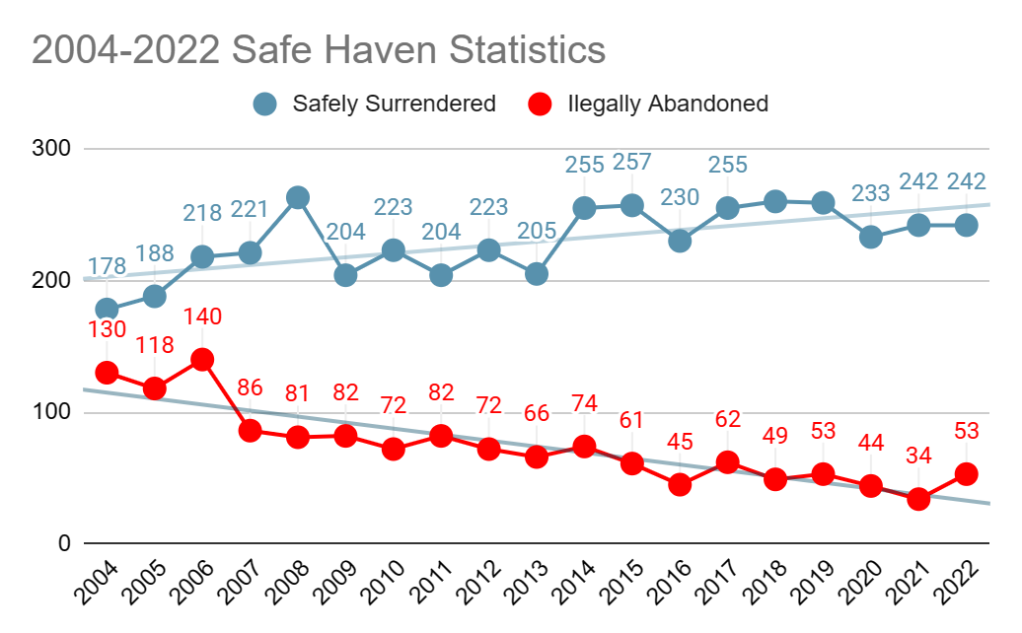
Safe Haven Laws in the US
Safe Haven laws protect vulnerable infants and parents. Studies show that illegal infant abandonment and infant homicide rates have decreased since the laws took effect. Safe Haven laws have saved over 4,700 infants in the US.

Slide 9

Safe Haven Laws
The state of Texas passed the ﬁrst Safe Haven laws in 1999. Within nine years, all other states had passed their own version of the laws. The laws are intended to protect infants
who may be abandoned by their parents in dangerous locations.
While the name and language of the laws vary from state to state,
the laws share some common themes:
1
Each state has a unique Safe Haven law.
2
The laws differ from state to state on details such as the maximum age an infant may be relinquished, approved locations and specific procedures to follow.
3
The laws provide safe options for a parent who may be unable or unwilling to care for their infant.
4
The laws allow a parent to anonymously relinquish an unharmed infant to a Safe Haven provider without prosecution.

Slide 10
Facilitating
Safety

Slide 11
NSHA Communication Model
Options for Mother/Parent
Before choosing to relinquish an infant, parents should be educated about all their options. The NSHA communication model includes sharing information and providing support to parents for the prevention of infant abandonment. These options include parenting, temporary placement, adoption and Safe Haven relinquishment.
Parenting Temporary Placement
Discuss what would cause the parent to feel they are unable to parent the infant.
Provide necessary parenting resources.
Inform the parent that a temporary placement option is available.

Slide 12
Adoption
Utilize adoption experts and resources if a mother is willing to consider this option.
NSHA does not place infants or facilitate adoption in any way.
NSHA utilizes a rotating list of agencies or www.adoptmatch.com.
Safe Haven Relinquishment
This is a life saving, last resort.
NSHA can help coordinate a safe process for the parent and infant.
Provide information regarding the state law, Safe Haven providers, and confidentiality.
If the parent contacts you regarding re-claiming custody of the infant, please direct the parent to contact the local Department of Child and Family Services or Department of Social Services to initiate this process and discuss options.

Slide 13
Safe Haven
Providers

Slide 14
Providing a Safe and Confidential Environment
Each designated Safe Haven location includes its own procedures that personnel must follow when accepting a relinquished infant. The priority is to provide a safe and confidential environment for a mother or parent.
Provide all options for a parent in a crisis situation.
Facilitate involvement with NSHA staff for further support.
Provide resources for the mother or parent; answer all questions.
Encourage women to deliver in the hospital, if possible.
Provide counseling resources for the mother or parent, if requested.

Slide 15




Designated Safe Haven Locations
In each state, there are designated Safe Haven locations. Parents must always relinquish an infant to
a staff member or may utilize an infant safety device at one of the designated Safe Haven locations, if available. Designated Safe Haven locations may vary depending on the state. Hospitals are approved locations in every state. Other common designated locations include fire stations, EMS stations and police stations.
Visit www.nationalsafehavenalliance.org/find-a-safe-haven for information about designated locations in your state.
Hospital
Fire Station
EMS
Police Station

Slide 16

Safe Haven Signage
Safe Haven locations will be marked with signage as shown in the image. Parents must always relinquish an infant to a staff member, or may utilize a newborn safety device at one of the designated Safe Haven locations.
The National Safe Haven Alliance provides signage to approved locations on their website at www.nationalsafehavenallia﻿nce.org/signage.

Slide 17



State Specific Signage
Some states will use a logo unique to the state for designated Safe Haven locations.
Below are some examples of different state's logos.

Slide 18
Best Practices for Safe Haven Providers
If you are a Safe Haven provider and an infant is relinquished to you, reference the following best practices. These practices are helpful guidelines regardless of the location.
Accept the Infant
Assume the infant is at risk for neglect and abandonment.
Ask for Information
Ask the parent if they are willing to provide information however, the parent is not required to provide information.
Transport the Infant to a Hospital
Call 911 for medical evaluation and transportation to the nearest Emergency Department. Fire and EMS will notify hospital staff of the Safe Haven relinquishment upon arrival.
Notify State Agency
Hospital staff to notify the appropriate state agency of the infant relinquishment and state agency will work to place the infant.

Slide 19

What if the child is older than the
Safe Haven law allows?
If a parent chooses to relinquish a child who is older than the age allowed by the Safe Haven law, follow the steps below:
1
Voluntarily accept the child; assume the child is at risk for abuse and neglect.
Encourage the parent to stay at the location to discuss safe placement options, such as Safe Families and foster care. If the parent chooses to leave the location, they will be at risk of prosecution. If the parent leaves, notify law enforcement and the appropriate state agency.
2
3
Call the NSHA Crisis Hotline for support and resources: 1-888-510-2229.
4
Transport the child to the nearest hospital for evaluation.

Slide 20

Best Practices for Hospital Staff
Designated Safe Haven locations have procedures that personnel must follow when accepting a relinquished infant. First, let’s look at procedures for hospital staff.

Slide 21


Hospital Staff
Step 1
Offer Support
Offer support and safe options to the mother/parent in a crisis pregnancy situation.
Facilitate conversation around temporary placement, family placement, adoption, and
Safe Haven relinquishment.

Slide 22

Hospital Staff
Step 2
Offer Counseling
If the parent chooses to make an adoption plan or to relinquish the infant using the Safe Haven law, offer counseling resources and direct support, such as the NSHA hotline, 1-888-510-BABY.

Slide 23
Hospital Staff
Step 3
Accept the Infant
If the parent still chooses to relinquish using the Safe Haven law, a hospital staff member will voluntarily accept the infant. If the relinquishment request is made after delivery, call the NSHA Crisis Hotline for direction, 1-888-510-BABY.

Slide 24

Hospital Staff
Step 4
Request Information
Request the parent to provide medical information, such as date of birth, and any other important facts about the infant. Note: If the parent declines this request, a Safe Haven provider cannot compel the parent to
provide this information.

Slide 25

Hospital Staff
Step 5
Admit the Infant
Admit the infant using confidential registration under hospital policy. Contact the NSHA Crisis Hotline for direction, 1-888-510-BABY.

Slide 26

Hospital Staff
Step 6
Support and Resources
Contact the NSHA Crisis Hotline for support and resources, 1-888-510-BABY.

Slide 27

Hospital Staff
Step 7
Notify State Agency
Notify the Department of Child and Family Services or Department of Social Services of the Safe Haven relinquishment. They will provide instruction regarding temporary custody and placement.

Slide 28

Best Practices for Fire/EMS
& Police Staff
Designated Safe Haven locations have procedures that personnel must follow when accepting a relinquished infant. These procedures apply to states that designate Fire/EMS or Police as a Safe Haven provider.

Slide 29

Attended EMS Staff
Step 1
Relinquishment
Parents may relinquish an infant at a fire, police, or EMS station, may utilize infant safety device,
if available or may call 9-1-1 to respond to the parent's location.

Slide 30
Attended EMS Staff
Step 2
Accept the Infant
Voluntarily accept the infant under the Safe Haven law.

Slide 31
Attended EMS Staff
Step 3
Request Information
Request the parent to provide medical information, such as date of birth, and any other important facts about the infant. Note: If the parent declines this request, a Safe Haven provider cannot compel the parent to provide this information.

Slide 32
Attended EMS Staff
Step 4
Provide medical care
Provide a medical evaluation of the infant and facilitate transportation to the nearest hospital.
Offer the mother medical evaluation and transportation to the hospital.

Slide 33


Attended EMS Staff
Step 5
Notify Hospital Staff
Notify hospital staff of the Safe Haven relinquishment prior to arrival.
If the mother is also transported, the mother and infant will be admitted separately.

Slide 34
Attended EMS Staff
Step 6
Support and Resources
Provide the parent with the NSHA Crisis Hotline, 1-888-510-BABY, for after-care and counseling resources, if needed.

Slide 35
Questions?
If you have any questions or for information regarding training for your staff, please contact the Safe Haven hotline at 1-888-510-2229.

Slide 36


Hospital Scenario
In this scenario, you are hospital personnel. Shortly after delivery, a parent comes up to you and says they need to relinquish their newborn infant under the Safe Haven law.

Slide 37

What are your first steps according to procedure?
Offer support and safe options to the mother/parent. Facilitate conversation around temporary placement and adoption.
Accept physical custody of the infant immediately, no questions asked.

Slide 38

Correct! This is the appropriate first step for
relinquishing a newborn at the time of delivery.
Offer support and safe options to the mother/parent. Facilitate conversation around temporary placement and adoption.
Accept physical custody of the infant immediately, no questions asked.

Slide 39


Emergency Medical Services Agency Scenario
In this scenario, you are employed by a fire department. During your shift, a parent comes up to you and says they need to relinquish their infant under the Safe Haven law.

Slide 40

What are your first steps according to procedure?
Accept the infant under the Safe Haven law.
Direct the mother/parent to contact the nearest hospital.

Slide 41

Correct! These are the appropriate first steps. The parent is not
required to provide any information about the infant. You should offer
the mother medical care and transportation to the hospital.
Accept the infant under the Safe Haven law.
Direct the mother/parent to contact the nearest hospital.

Slide 42
After Relinquishment

Slide 43
What happens to the infant?
After an infant is relinquished, multiple agencies work together to ensure the infant is healthy, uninjured and ultimately placed into a permanent home. The process may vary, depending on the state. Be familiar with your state’s law and procedures. Review the steps to learn more about the process.
Step 1
An infant is accepted under the Safe Haven Law.
Step 2
The infant receives a medical evaluation. If needed, the infant is admitted to the hospital for further evaluation and treatment.

Slide 44
Step 3
In most states, a hospital social worker notifies the appropriate state agency, such as the Department of Child and Family Services or Department of Social Services of the Safe Haven relinquishment.
Step 4
The state agency or licensed child placing agency is authorized to take custody of the infant and begin the legal process for placement.
Step 5
After the infant is discharged, the state agency arranges appropriate placement for the infant.
Step 6
The state agency begins the process of terminating parental rights to the infant.
Step 7
Once parental rights are terminated, the infant is available for adoption.

Slide 45
Rights of
Relinquishing Parents

Slide 46


Rights of Relinquishing Parents
Under the Safe Haven laws, parents have certain rights which protect them if they choose to relinquish their infant. These rights may vary, depending on the state. Be familiar with your state’s law and procedures.
Liability
The parent is shielded from criminal and civil liability and prosecution for infant endangerment, abandonment, or neglect IF the requirements for a Safe Haven relinquishment are met.
Right to Request
Parents have the right to request a private adoption for the infant.

Slide 47


Right to Refuse
Parents have the right to decline a request to provide medical information or other facts about
the infant.
Right to Contact DSS
The parent has the right to contact the Department of Child and Family Services or Department of Social Services about reclaiming parental rights of their infant.

Slide 48
Course Summary

Slide 49
Course Conclusion
In summary, Safe Haven laws provide a safe alternative for infants who may be abandoned by their parents in dangerous locations. Parents may relinquish an infant at a designated Safe Haven provider. Each state law includes details such as approved locations and the maximum age of the relinquished infant.
When an infant is relinquished, staff should ask the parent to provide information about the infant, but the parent isn’t required to comply. The infant should receive any necessary medical care and the designated state agency should be notified of the relinquishment.

Slide 50
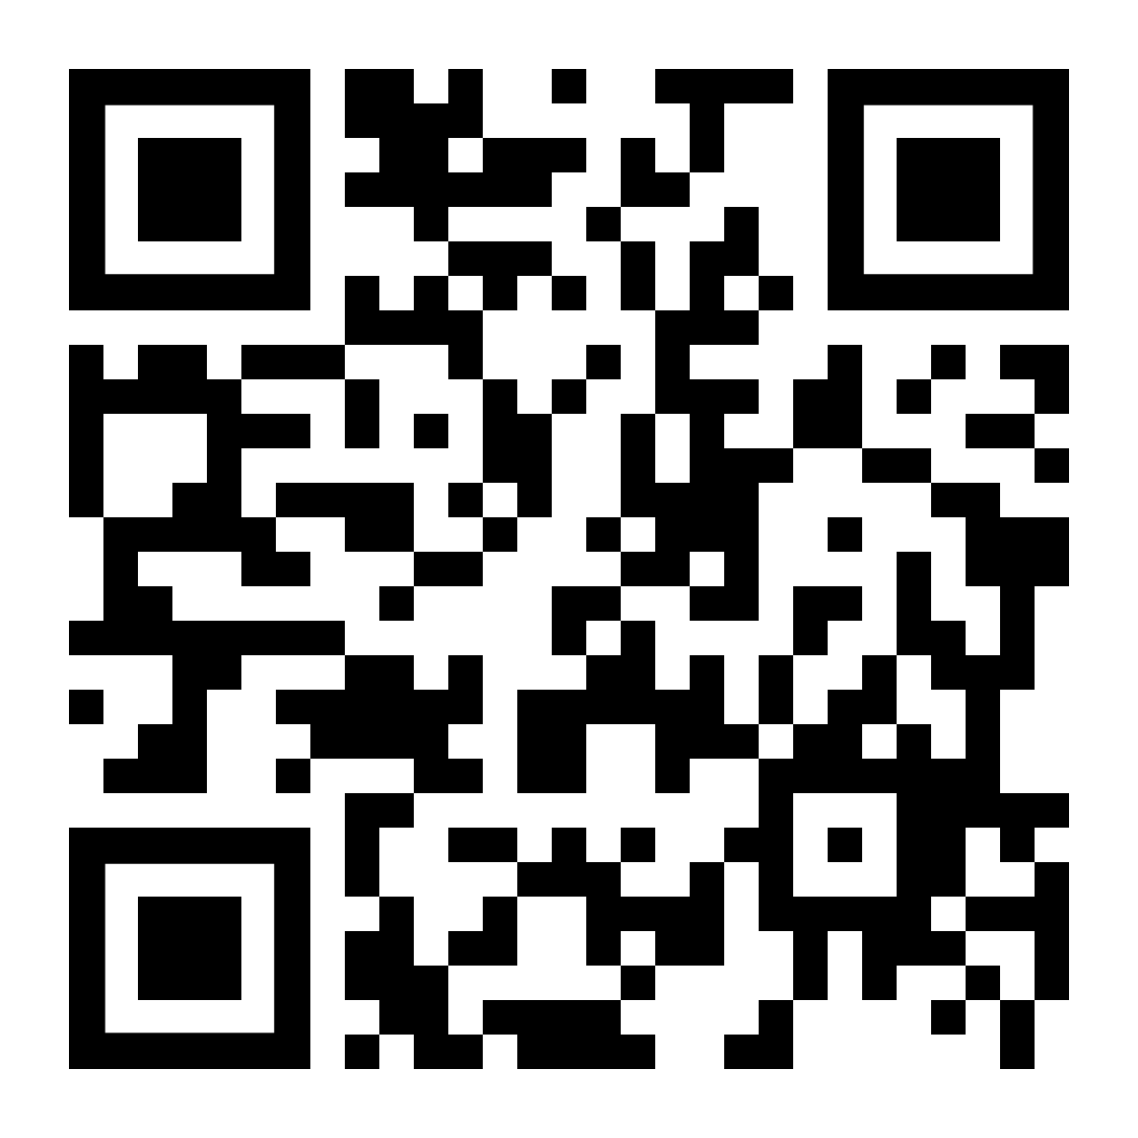
Course Evaluation
Please take a moment to evaluate this training. Scan the code with your cell phone camera to open the evaluation. You may also go to https://form.jotform.com/233187109885163.
A course certificate will be emailed to you after you have completed the evaluation.

Slide 51

How Can NSHA help?
NSHA provides a variety of resources that are offered to mothers and parents, Safe Haven providers, and the community:
Support for mother/parent.
Best practice national model.
24/7 Safe Haven Crisis hotline services
Community education (in schools)
State-specific, Safe Haven awareness tools and resources.
Support and training for Safe Haven providers.
Community resources for parents
Comprehensive healthcare system
and facility training.
Signs for Safe Haven Providers.

Slide 52
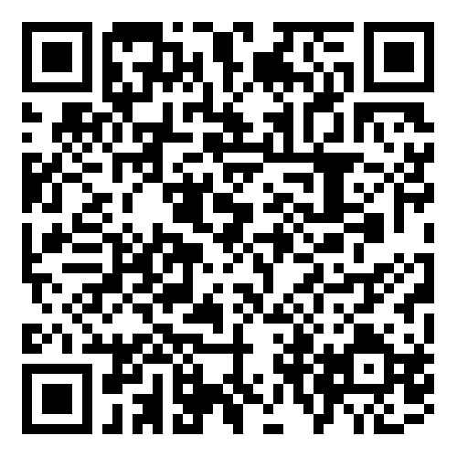
Available Resources
The National Safe Haven Alliance (NSHA) is a national resource for providers and parents considering infant relinquish. Visit their website at www.nationalsafehavenallia﻿nce.org. To reach a live agent, call or text their 24/7 Crisis Hotline: 1-888-510-BABY (2229).
The NSHA site also provides downloadable resources such as brochures, information cards and posters.

Slide 53
Course Complete
Congratulations! You've completed
this training.
For training, Safe Haven signage or more information, visit the NSHA website at www.nationalsafehavenalliance.org or call
1-888-510-2229.

